Slide 1
BME3053c Final Project
Alzheimer’s MRI Deep Learning Model
Khadeejah Ahmed, Salma Ouaakki, Harshnasri Pinapala, Alyssa Collier, Madeline Osinski

Slide 2
Project Overview
Objective:
Develop an AI model that analyzes MRI scans of Alzheimer’s patients to determine the stage of dementia.
Classify the MRI images into four stages of Alzheimer’s: no impairment, very mild impairment, mild impairment, and moderate impairment.
Approach:
Model: Implemented a CNN-based image classification pipeline using TensorFlow and Keras.
Data set: Utilized the “Best Alzheimer MRI Dataset (99% Accuracy)” sourced from Kaggle, containing grayscale MRI images categorized into four classes
Notes:
The purpose of our project is to

Slide 3
Problem
MRIs are currently analyzed by Radiologists
Human error
Slower analyzation
Delayed treatment plans and insurance coverage
There can be discrepancies in hard to diagnose cases
Mixed cases
More precision in spotting small changes
Deep learning models can predict the onset of the disease
Notes:
MRIs are currently analyzed and interpreted by radiologists. Though these are highly trained professionals, they are still subject to human error and require time to process results and develop treatment plans. A well-trained, automated system would save doctors from the time involved in interpreting this data and reviewing errors, allowing patients to receive more accurate help sooner. This would not only patients medically, but also financially, as a faster diagnosis leads to a faster treatment plan, which leads to faster insurance coverage
Additionally, once a model is fully trained, patients, families, and healthcare plans can feel more secure in the diagnoses as they have machine-like accuracy and precision. This can be especially useful in cases that are hard for doctors to diagnose, such as mixed dementia cases, and scans with very minute, but important changes.
Lastly, deep learning models can be trained to analyze a patient’s scan, cognitive background, and medical history to predict for the onset of Alzheimer’s Disease and how it will progress. Some of these models are able to do so with up to 80% accuracy. Without the continued use and progression of deep learning models, this ability would not be possible, emphasizing the need for AI in medicine.

Slide 4
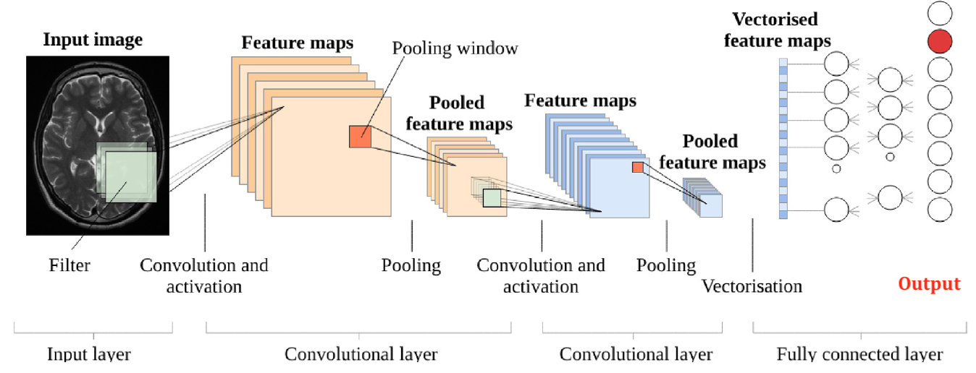
Problem
Current machine learning models exist:
Detecting MRI scans for early onset of Alzheimer’s disease
Convoluted Neural Networks (CNNs) can analyze MRI scans and classify the stages of Alzheimer's disease

Slide 5

Significance
Our model provides a quick, non-invasive way to track a patients disease progression.
It provides a quantitative metric for insurance and other medical providers.
Having a staging tools always clinicians to communicate more effectively.

Slide 6
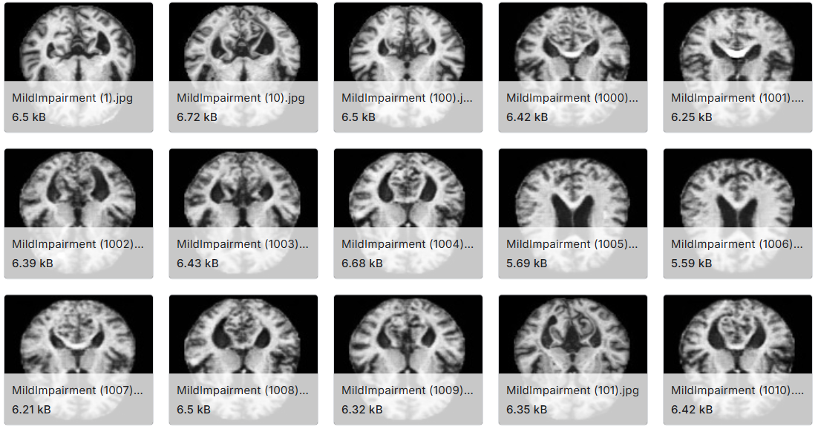
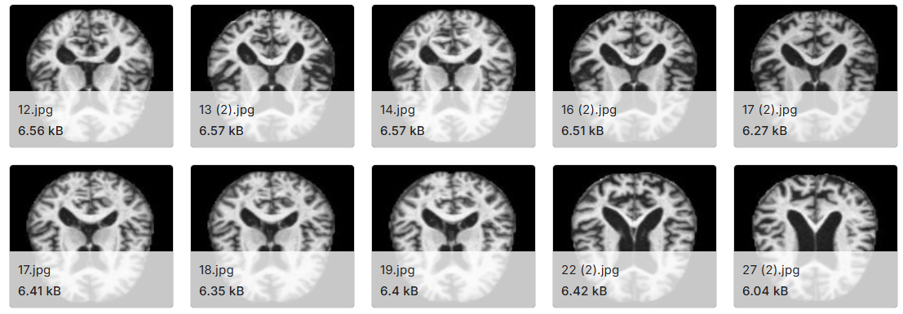
Data
Alzheimer's MRI dataset from Kaggle
Notes:
To train our image classification mode, we first downloaded an Alzheimer’s MRI dataset from Kaggle directly, within Google Colab. This required uploading a personal Kaggle API key to authenticate and access the dataset. The images were loaded from the dataset and converted to grayscale with a size of 128x128 pixels. We normalized the pixel values so that they ranged from 0 to 1 for better model performance

Slide 7
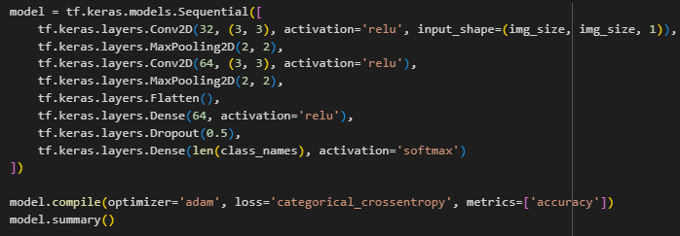
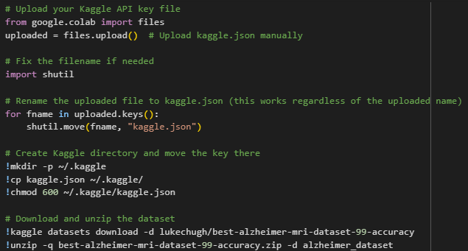

Methodology
Fig. 1. Model layers
Fig. 3. Uploading and unzipping the data
Fig. 2. Normalizing pixel values
Notes:
Our model is a convolutional neural network with 2 convolutional layers and a final output layer that predicts one of 4 impairment levels. We trained it for 5 epochs using the Adam optimizer, then evaluated its performance with accuracy metrics and a confusion matrix.

Slide 8
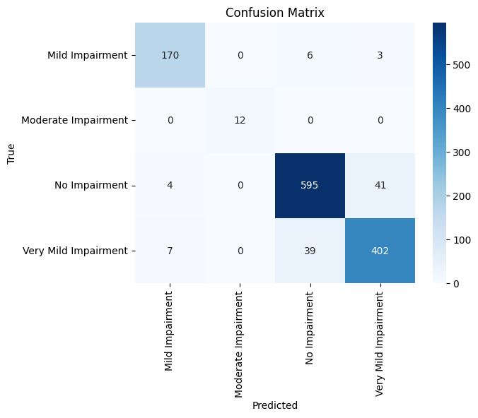
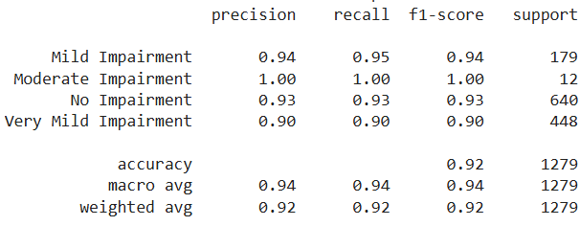
Results
Fig. 2. Confusion matrix
Fig. 1. Classification Report
Notes:
Our weighted average F1 score of 0.92 suggests the model is effective as predicting impairment levels. Our confusion matrix shows that Non Demented patients were correctly identified 595 times with a minor confusion toward Very Mild cases (41 instances). Very Mild Demented cases were also well predicted (402 correct), but the model occasionally confused them with Non Demented (39 instances). Mild Demented was correctly predicted 170 times, with only 9 misclassifications. Moderate Demented, despite having the fewest samples, was perfectly classified with no confusion.

